Slide 1
Introduction
Introduction to Data Science

Slide 2
The Human Data Point
Share one quantifiable piece of data about yourself.
It could be the number of cups of coffee you have consumed today, the distance you traveled to get to class, or the number of unread emails in your inbox.

Slide 3
Motivation
The technology revolution has brought about the need to process, store, analyze, and comprehend large volumes of diverse data in meaningful ways. The value of the stored data is zero unless it is acted upon.
Some real-world examples that you encounter daily:
Recommendation Engines: How does Netflix know what you want to watch next?
Spam Filtering: How does your email provider keep your inbox (mostly) clean?
Personalized Advertising: Why do you see ads for something you just searched for?

Slide 4
Introduction
Data science is a compilation of techniques that extract value from data.
Data science techniques rely on finding useful patterns, connections, and relationships within data.
Data science is also commonly referred to as knowledge discovery, machine learning, predictive analytics, and data mining.
The use of the term science in data science indicates that the methods are evidence based, and are built on empirical knowledge, more specifically historical observations.

Slide 5
Who uses Data Science today?
Almost every organization and business.

Slide 6
Data Science Techniques
Decision trees,
Regression models,
Deep learning,
Clustering
…

Slide 7
AI, Machine Learning, and Data Science
Artificial intelligence, Machine learning, and data science are all related to each other.
Unsurprisingly, they are often used interchangeably and conflated with each other in popular media and business communication.
However, all of these three fields are distinct depending on the context.

Slide 8
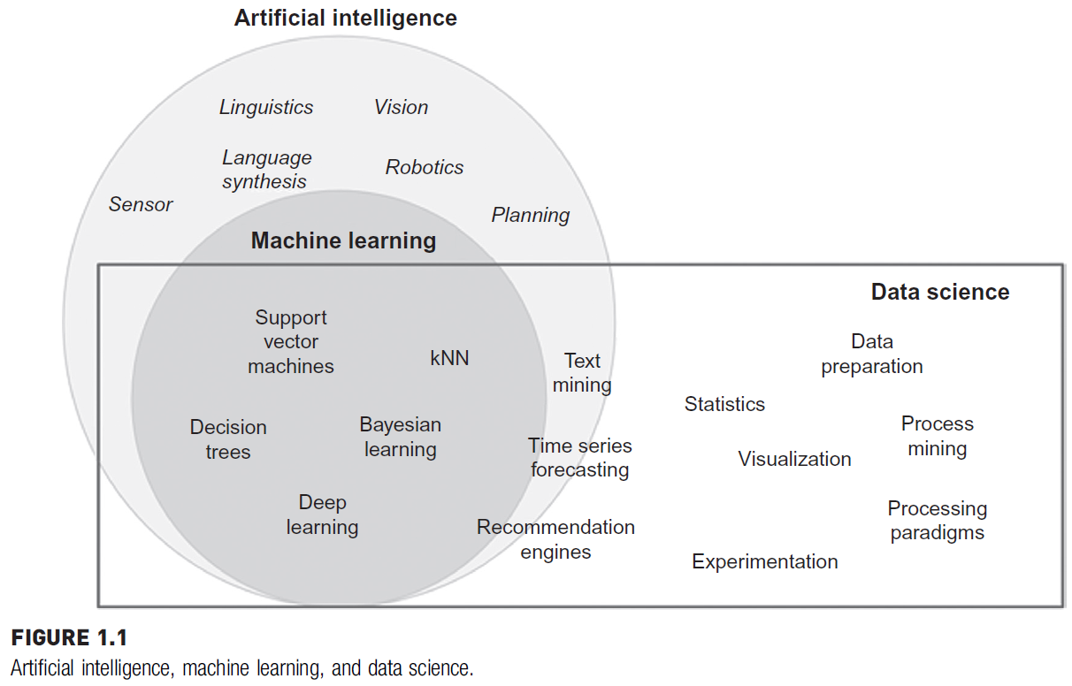
AI, Machine Learning, and Data Science

Slide 9
Artificial Intelligence
Artificial intelligence is about giving machines the capability of mimicking human behavior, particularly cognitive functions.
Examples: Facial recognition, automated driving, sorting mail based on postal code…
A range of techniques that fall under artificial intelligence:
linguistics,
natural language processing,
decision science,
vision,
robotics,
planning, etc.

Slide 10
Machine Learning
Machine learning can either be considered a sub-field or one of the tools of artificial intelligence, is providing machines with the capability of learning from experience.
Experience for machines comes in the form of data.
Machine learning algorithms, also called “learners”, take both the known input and output (training data) to figure out a model for the program which converts input to output.
For example, many organizations like social media platforms, review sites, or forums are required to moderate posts and remove abusive content.

Slide 11
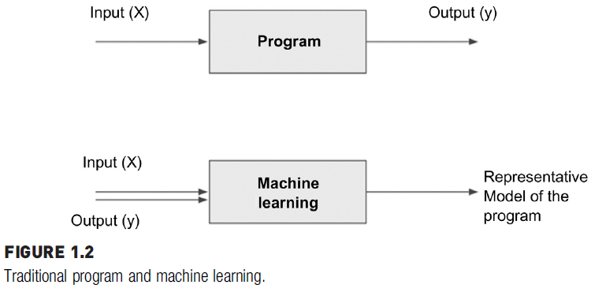
Machine Learning
Machine learning turns the traditional programing model upside down.

Slide 12
Data Science
Data science is the business application of machine learning, artificial intelligence, and other quantitative fields like statistics, visualization, and mathematics.
It is an interdisciplinary field that extracts value from data.
It relies heavily on machine learning.
Examples of data science user cases are:
recommendation engines that can recommend movies for a particular user,
a fraud alert model that detects fraudulent credit card transactions,
find customers who will most likely buy a product, or predict revenue for the next quarter.

Slide 13
What is Data Science?
Data science starts with data, which can range from a simple array of a few numeric observations to a complex matrix of millions of observations with thousands of variables.
Data science utilizes certain specialized computational methods in order to discover meaningful and useful structures within a dataset.
The discipline of data science coexists and is closely associated with a number of related areas such as database systems, data engineering, visualization, data analysis, experimentation, and business intelligence (BI).
Data science is a collection of techniques used to extract value from data.

Slide 14
Dataset
Student ID | Name | Age | Gender | Math Score | English Score | Attendance (%)
101 | Alice | 17 | F | 85 | 88 | 95
102 | Bob | 18 | M | 78 | 74 | 80
103 | Charlie | 17 | M | 92 | 90 | 98
104 | Daisy | 18 | F | NA | 85 | 88
105 | Eva | 19 | F | 70 | -10 | 75
106 | Frank | NA | M | 88 | 84 | NA
107 | Grace | 17 | F | 95 | 95 | 100
108 | Henry | 18 | M | 60 | 65 | 60

Slide 15
Key Features and Motivations
Extracting Meaningful Patterns
Building Representative Models
Combination of Statistics, Machine Learning, and Computing
Learning Algorithms
Associated Fields

Slide 16
Extracting Meaningful Patterns
Knowledge discovery in databases is the nontrivial process of identifying valid, novel, potentially useful, and ultimately understandable patterns or relationships within a dataset in order to make important decisions.
One of the key aspects of data science is the process of generalization of patterns from a dataset.
The term novel indicates that data science is usually involved in finding previously unknown patterns in data.
The ultimate objective of data science is to find potentially useful conclusions that can be acted upon by the users of the analysis.

Slide 17
Building Representative Models
In statistics, a model is the representation of a relationship between variables in a dataset.
It describes how one or more variables in the data are related to other variables.
Modeling is a process in which a representative abstraction is built from the observed dataset.
For example, based on credit score, income level, and requested loan amount, a model can be developed to determine the interest rate of a loan.

Slide 18
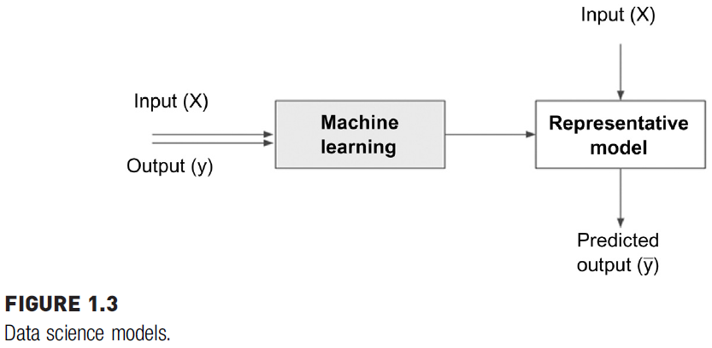
Building Representative Models

Slide 19
Building Representative Models
Data science is the process of building a representative model that fits the observational data.
This model serves two purposes:
it predicts the output (interest rate) based on the new and unseen set of input variables (credit score, income level, and loan amount)
the model can be used to understand the relationship between the output variable and all the input variables.
For example,
does income level really matter in determining the interest rate of a loan?
Does income level matter more than credit score?
What happens when income levels double or if credit score drops by 10 points?
A Model can be used for both predictive and explanatory applications.

Slide 20
Combination of Statistics, Machine Learning, and Computing
In the pursuit of extracting useful and relevant information from large datasets, data science borrows computational techniques from the disciplines of statistics, machine learning, and database theories.
One of the key ingredients of successful data science is substantial prior knowledge about the data and the business processes that generate the data, known as subject matter expertise.
Like many quantitative frameworks, data science is an iterative process in which the practitioner gains more information about the patterns and relationships from data in each cycle.

Slide 21
Learning Algorithms
We can also define data science as a process of discovering previously unknown patterns in data using automatic iterative methods.
The application of sophisticated learning algorithms for extracting useful patterns from data differentiates data science from traditional data analysis techniques.
Based on the problem, data science is classified into tasks such as classification, association analysis, clustering, and regression. Each data science task uses specific learning algorithms like decision trees, neural networks, k-nearest neighbors (k-NN), and k-means clustering, among others.

Slide 22
Associated Fields
While data science covers a wide set of techniques, applications, and disciplines, there a few associated fields that data science heavily relies on:
Descriptive statistics
Exploratory visualization
Dimensional slicing
Hypothesis testing
Data engineering
Business intelligence
Notes:
Descriptive statistics: Computing mean, standard deviation, correlation,
and other descriptive statistics, quantify the aggregate structure of a dataset.
Exploratory visualization: The process of expressing data in visual
coordinates enables users to find patterns and relationships in the data
and to comprehend large datasets.
Dimensional slicing: Online analytical processing (OLAP) applications,
which are prevalent in organizations, mainly provide information on
the data through dimensional slicing, filtering, and pivoting.
Hypothesis testing: In confirmatory data analysis, experimental data are
collected to evaluate whether a hypothesis has enough evidence to be
supported or not.
Data engineering: Data engineering is the process of sourcing,
organizing, assembling, storing, and distributing data for effective
analysis and usage.
Business intelligence: Business intelligence helps organizations consume
data effectively. It helps query the ad hoc data without the need to
write the technical query command or use dashboards or visualizations
to communicate the facts and trends.

Slide 23
Case for Data Science
Data science is one such paradigm that can handle large volumes with multiple attributes and deploy complex algorithms to search for patterns from data.
Key motivations for using data science techniques:
Volume
Dimensions
Complex Questions

Slide 24
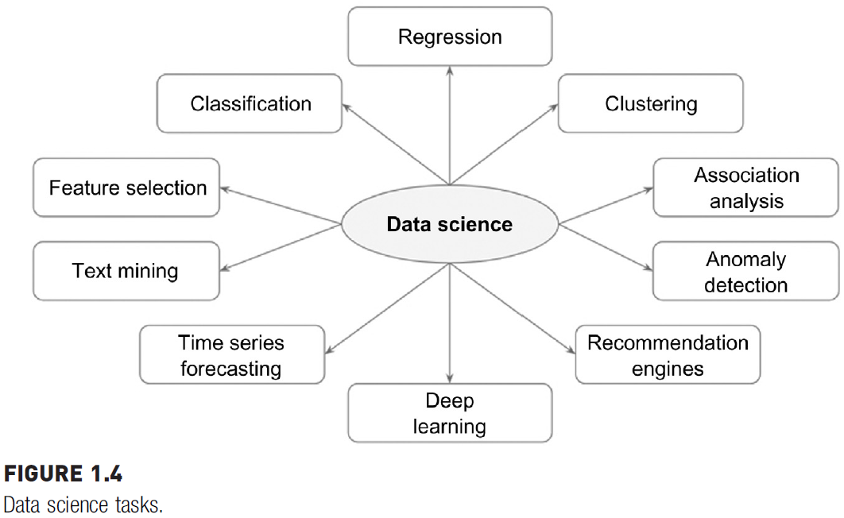
Data Science Classification

Slide 25
Data Science Algorithms
Next slide provides a summary of data science tasks with commonly used algorithmic techniques and example cases.

Slide 26
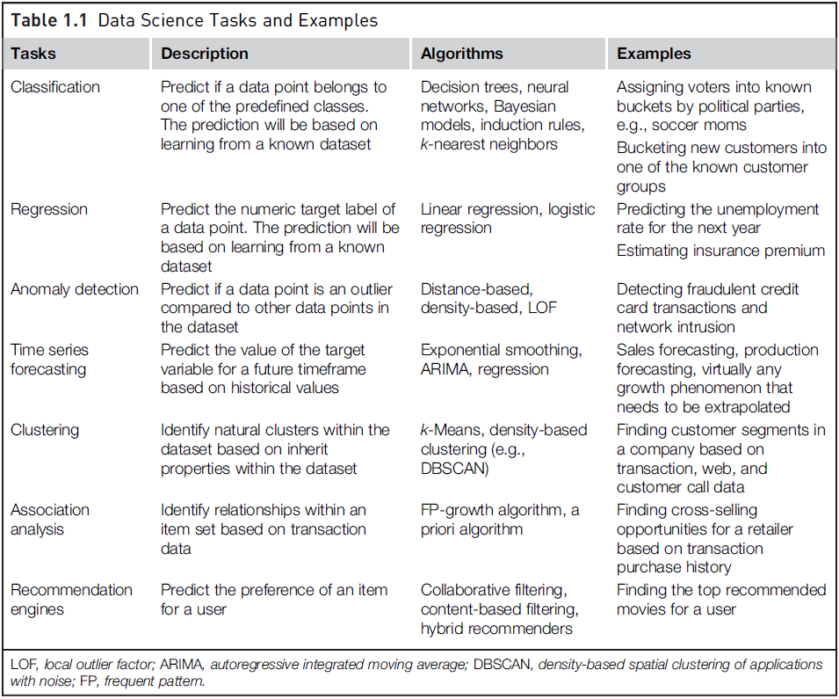
Data
Science
Algorithms

Slide 27
Applications of Data Science
Internet Search
Transport
Finance
HealthCare
Image Recognition
Airline Routing Planning
Data Science in Gaming
Notes:
1. Internet Search: The most useful application of Data Science is Search Engines. As we know when we want to search for something on the internet, we mostly used Search engines like Google, Yahoo, Safari, Firefox, etc. So Data Science is used to get Searches faster.
2. Transport: Data Science also entered into the Transport field like Driverless Cars. With the help of Driverless Cars, it is easy to reduce the number of Accidents.
3. Finance : Data Science plays a key role in Financial Industries. Financial Industries always have an issue of fraud and risk of losses. Thus, Financial Industries needs to automate risk of loss analysis in order to carry out strategic decisions for the company. Also, Financial Industries uses Data Science Analytics tools in order to predict the future. It allows the companies to predict customer lifetime value and their stock market moves.
4. Health Care: In the Healthcare Industry data science act as a boon. Data Science is used for:
Detecting Tumor
Drug discoveries.
Medical Image Analysis.
Virtual Medical Bots.
Genetics and Genomics.
Predictive Modeling for Diagnosis etc..
5. Image Recognition : Currently, Data Science is also used in Image Recognition. For Example, When we upload our image with our friend on Facebook, Facebook gives suggestions Tagging who is in the picture. This is done with the help of machine learning and Data Science. When an Image is Recognized, the data analysis is done on one’s Facebook friends and after analysis, if the faces which are present in the picture matched with someone else profile then Facebook suggests us auto-tagging.
6. Airline Routing Planning : With the help of Data Science, Airline Sector is also growing like with the help of it, it becomes easy to predict flight delays. It also helps to decide whether to directly land into the destination or take a halt in between like a flight can have a direct route from Delhi to the U.S.A or it can halt in between after that reach at the destination.
7. Data Science in Gaming : In most of the games where a user will play with an opponent i.e. a Computer Opponent, data science concepts are used with machine learning where with the help of past data the Computer will improve its performance. There are many games like Chess, EA Sports, etc. will use Data Science concepts.

Slide 28
References
Data Science: Concepts and Practice by Vijoy Kotu , Bala Deshpande (2nd Edition)

